Slide 1

Analyzing Mental Health:
Text Classification for Mental Health Conditions
Course Lecturer: Dr. Alexander(Sasha) Apartsin
Shahar Saadon | 206560526
Dudi Saadia | 318970944
Shanel Asulin | 205616014

Slide 2

Introduction
Problem & Objectives
Problem Description
We aim to classify a person's mental or emotional state based on a short text message (like a post or chat).
Why is it important?
It can help detect mental health issues early and support professionals in understanding emotional states.
Why is it challenging?
The texts are short, vague, and often written in informal or inconsistent language.

Slide 3
Introduction
Problem & Objectives
Project Goals
Explore if machine learning can classify emotional states from text.
Compare several models to find the best one.
Understand which words are most important for each emotion.

Slide 4
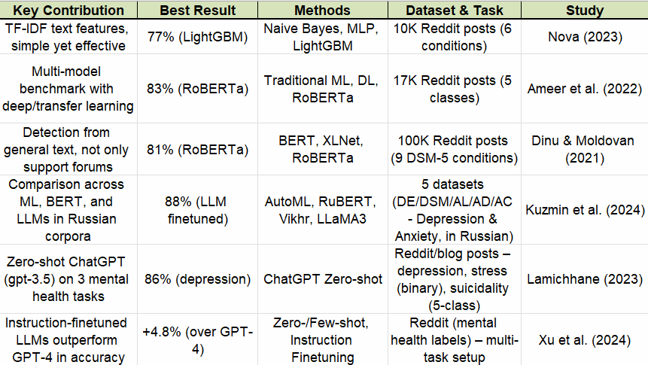
Literature Review

Slide 5
Dataset & Preparation
Data Sources
Main dataset: Over 53,000 text statements labeled from Kaggle with 7 mental health states.
https://www.kaggle.com/datasets/suchintikasarkar/sentiment-analysis-for-mental-health
Additional dataset: Statements labeled by depression levels (Mild, Severe, Normal)
https://github.com/rafalposwiata/depression-detection-lt-edi-2022
Merging Strategy
We added the new data to increase the number of examples.
>>All “Mild” and “Severe” were labeled as Depression
>>All “Normal” statements were labeled as Normal
Final Format
Text: short English statements from social media
Label: one of 7 categories (e.g., Anxiety, Depression, Stress, etc.)

Slide 6
Models and Processing Pipelines
Transform text into vectors (TF-IDF)
Train classical models (NB, LogReg, SVM, RF, XGB)
Evaluate on test set → Accuracy, Precision, Recall, F1
Clean and label data
Tokenize with BERT WordPiece
Fine-tune DistilBERT: * frozen-base *unfreeze-2 * full FT

Slide 7
What we used:
Text preprocessing: TF-IDF vectorization with and without n-grams.
Models:
Naive Bayes
Logistic Regression
SVM
Random Forest
XGBoost
BERT
DistilBERT
Training details:
* Train/Test split: 80/20.
*Balanced classes: using stratified split.
* Platform: local Jupyter Notebook.
* Batch size & epochs: default values for classical models.
For DistilBERT:
4 epochs, 2x4 batch.
(4×2 = batch 4, grad-acc 2)

Slide 8
How We Used the Metrics
Metrics Overview
• Accuracy – overall correctness
• Precision – false-alarm control
• Recall – catch positives
• F1 – balance P/R
During training/testing –
• Training: monitor val-loss & F1, stop if plateau.
• Testing: rank models by macro-F1.
Why we used multiple metrics - Accuracy can mislead on imbalanced data, so we rely on macro-F1 for fair comparison

Slide 9
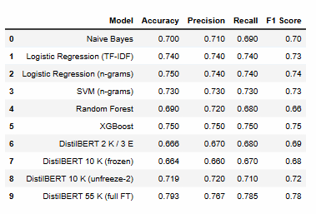
Intermediate & Baseline Results

Slide 10
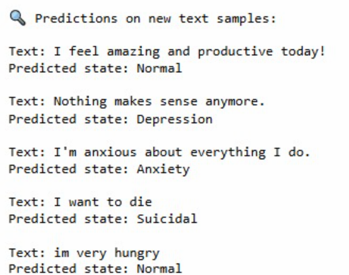
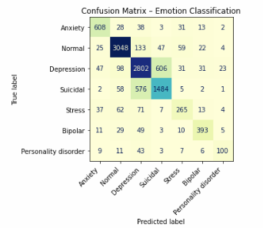
DstilBERT Results

Slide 11
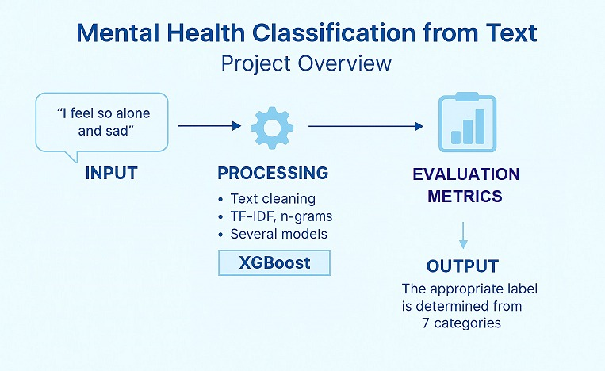
Graphical abstract
(Depression)

Slide 12
Thank You ☺

